Slide 1

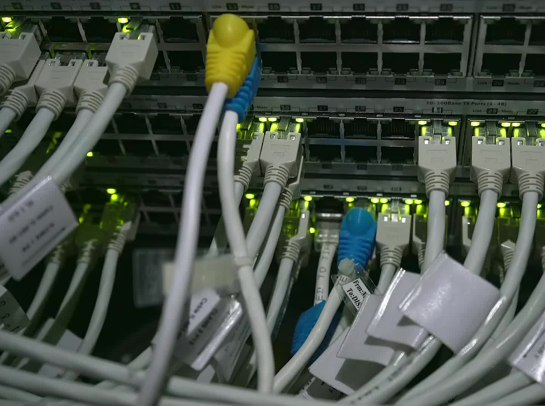


CS621 Parallel and Distributed Computing
Dr. Muhammad Anwaar Saeed
Dr. Said Nabi
Ms. Hina Ishaq

Slide 2
CS621 Parallel and Distributed Computing
Shared Memory

Slide 3
Objectives
Introduction of Shared Memory.
Architecture of Shared Memory.

Slide 4
Shared Memory:
“Shared memory is a type of memory architecture that allows multiple processors or threads to access the same memory space. In the context of distributed and parallel computing, shared memory can be used to facilitate communication and synchronization between different processes or threads.”

Slide 5
Shared Memory:
Processors have direct access to global memory and I/O
through bus or fast switching network
Cache Coherency Protocol guarantees consistency
of memory and I/O accesses
Each processor also has its own memory (cache)

Slide 6


Shared Memory Cont…
Data structures are shared in global address space
Concurrent access to shared memory must be coordinated
Programming Models
Multithreading (Thread Libraries)
OpenMP

Slide 7
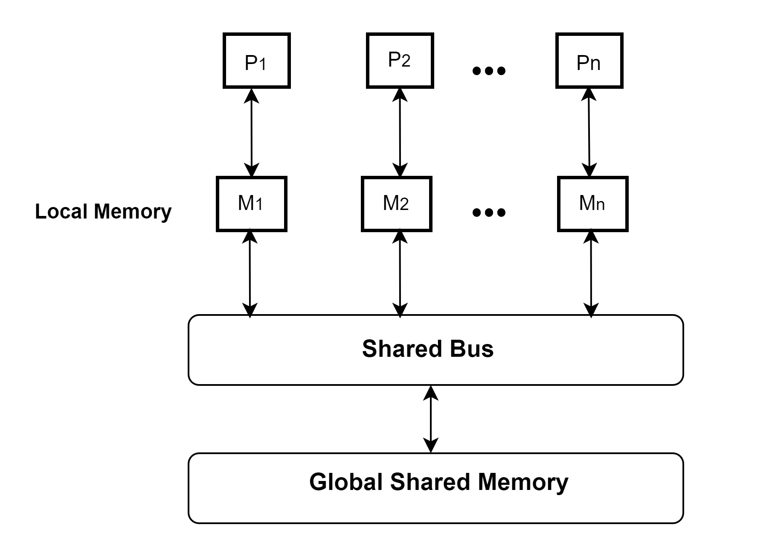
Architecture of Shared Memory:

Slide 8
CS621 Parallel and Distributed Computing
Distributed Memory

Slide 9
Objectives
Introduction of Distributed Memory.
Architecture of Distributed Memory.

Slide 10
Distributed Memory:
“Distributed memory refers to a type of parallel computing architecture where each processor has its own private memory, and communication between processors happens through message passing. In this architecture, the memory of one processor is not directly accessible by other processors, and communication between processors occurs explicitly through messages that are sent and received.”

Slide 11
Distributed Memory:
Each Processor has direct access only to its local memory
Processors are connected via high-speed interconnect
Data structures must be distributed

Slide 12
Distributed Memory Cont…
Data exchange is done via explicit processor-to-processor communication: send/receive messages
Programming Models
Widely used standard: MPI
Others: PVM, PARMACS, Express, P4, Chameleon, etc.

Slide 13
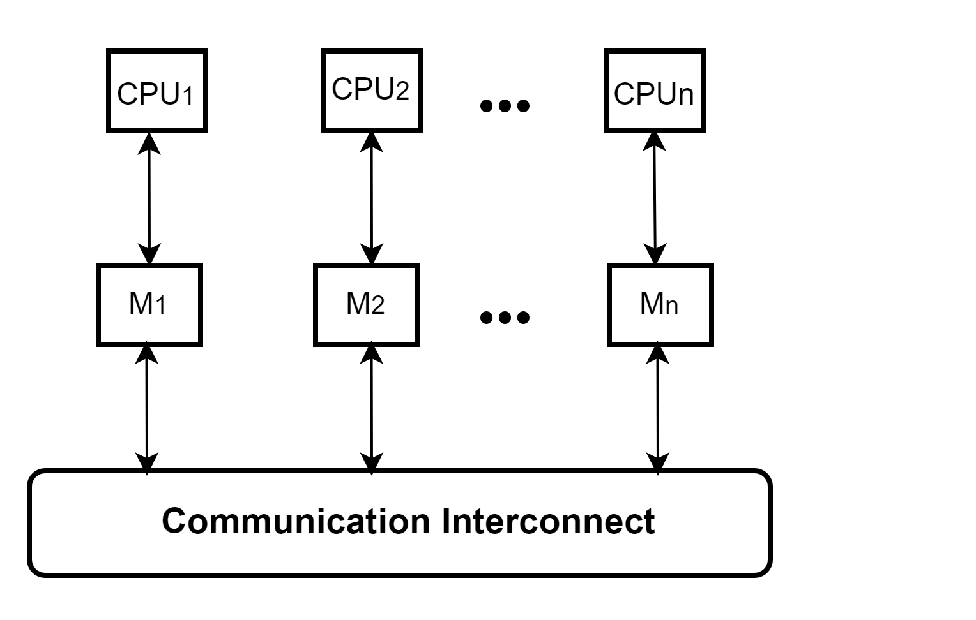
Architecture of Distributed Memory:

Slide 14
CS621 Parallel and Distributed Computing
Flynn’s classification of computer architectures

Slide 15
Objectives
What is Flynn’s classification of computer architectures?
Basis for Flynn’s classification.
Types of Flynn’s classification.

Slide 16
Flynn’s classification of computer architectures (1966):
“Michael J Flynn classified computers on the basis of multiplicity of instruction stream and data streams in a computer system.”

Slide 17
Flynn’s classification of computer architectures Cont…
Instruction stream
Data stream
Single vs. multiple

Slide 18
Flynn’s classification of computer architectures Cont…
The four classifications defined by Flynn are based upon the number of concurrent instruction (or control) and data streams available in the architecture.
Single Instruction Single Data (SISD)
Single Instruction Multiple Data (SIMD)
Multiple Instruction Multiple Data (MIMD)
Multiple Instruction Single Data (MISD)

Slide 19
Flynn’s classification of computer architectures Cont…
Single
Multiple
instruction
instruction
Single data
SISD
MISD
Multiple data
SIMD
MIMD

Slide 20
CS621 Parallel and Distributed Computing
SISD (Single-Instruction Single-Data)

Slide 21
Objectives
Introduction of SISD.
Architecture of SISD.

Slide 22
SISD (Single-Instruction Single-Data)
“Refers to the traditional von Neumann architecture where a single sequential processing element (PE) operates on a single stream of data.”

Slide 23
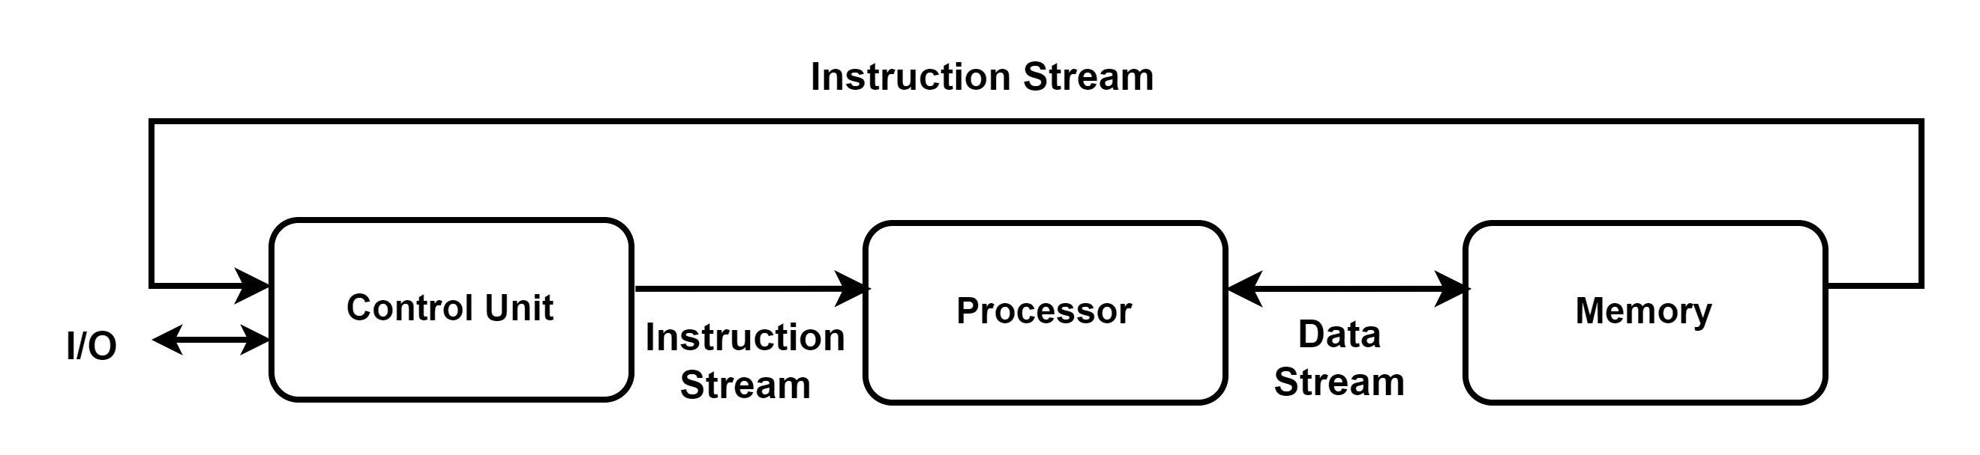
SISD (Single-Instruction Single-Data) Architecture

Slide 24
SISD (Single-Instruction Single-Data) Cont…
Conventional single-processor von Neumann computers are classified as SISD systems.
A typical non-pipelined architecture with general purpose registers as well as some dedicated special registers like:
Program Counter (PC),
Memory data registers (MDR),
Memory address registers (MAR) and
Instruction registers (IR).

Slide 25
SISD (Single-Instruction Single-Data) Cont…
Perform the same operation on multiple data operands concurrently.
Concurrency of processing rather than concurrency of execution.
Serial computer
Example: A personal computer processing instructions and data on single processor.

Slide 26
CS621 Parallel and Distributed Computing
SIMD (Single-Instruction Multi-Data)

Slide 27
Objectives
Introduction of SIMD.
SIMD Architecture.
SIMD Schemes.

Slide 28
SIMD (Single-Instruction Multi-Data)
“SIMD is a multiple-processing system that performs one operation simultaneously on more than one piece of data.”

Slide 29
SIMD (Single-Instruction Multi-Data) Cont…
Only one program can be run at a time.
All processors in a parallel computer execute the same instructions but operate on different data at the same time.
Processors run in synchronous, lockstep function.
Shared or distributed memory
SIMD instructions give very speedups in things like linear algebra, or image/video manipulation/encoding/decoding, etc.
Examples: Wireless MMX unit, CM-1, CM-2, DAP, MasPar MP-1

Slide 30
SIMD (Single-Instruction Multi-Data) Architecture
Consists of 2 parts:
A front-end Von Neumann computer.
A processor array: connected to the memory bus of the front end.

Slide 31
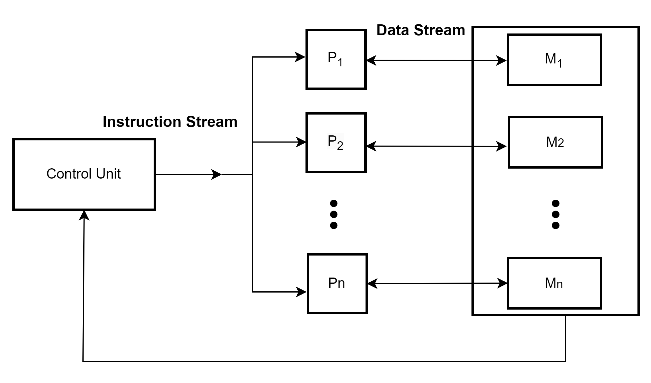
SIMD (Single-Instruction Multi-Data) Architecture Cont…

Slide 32
SIMD (Single-Instruction Multi-Data) Schemes
Classified into two configuration schemes
Scheme 1 – Each processor has its own local memory.
Scheme 2 – Processors and memory modules communicate with each other via interconnection network.

Slide 33
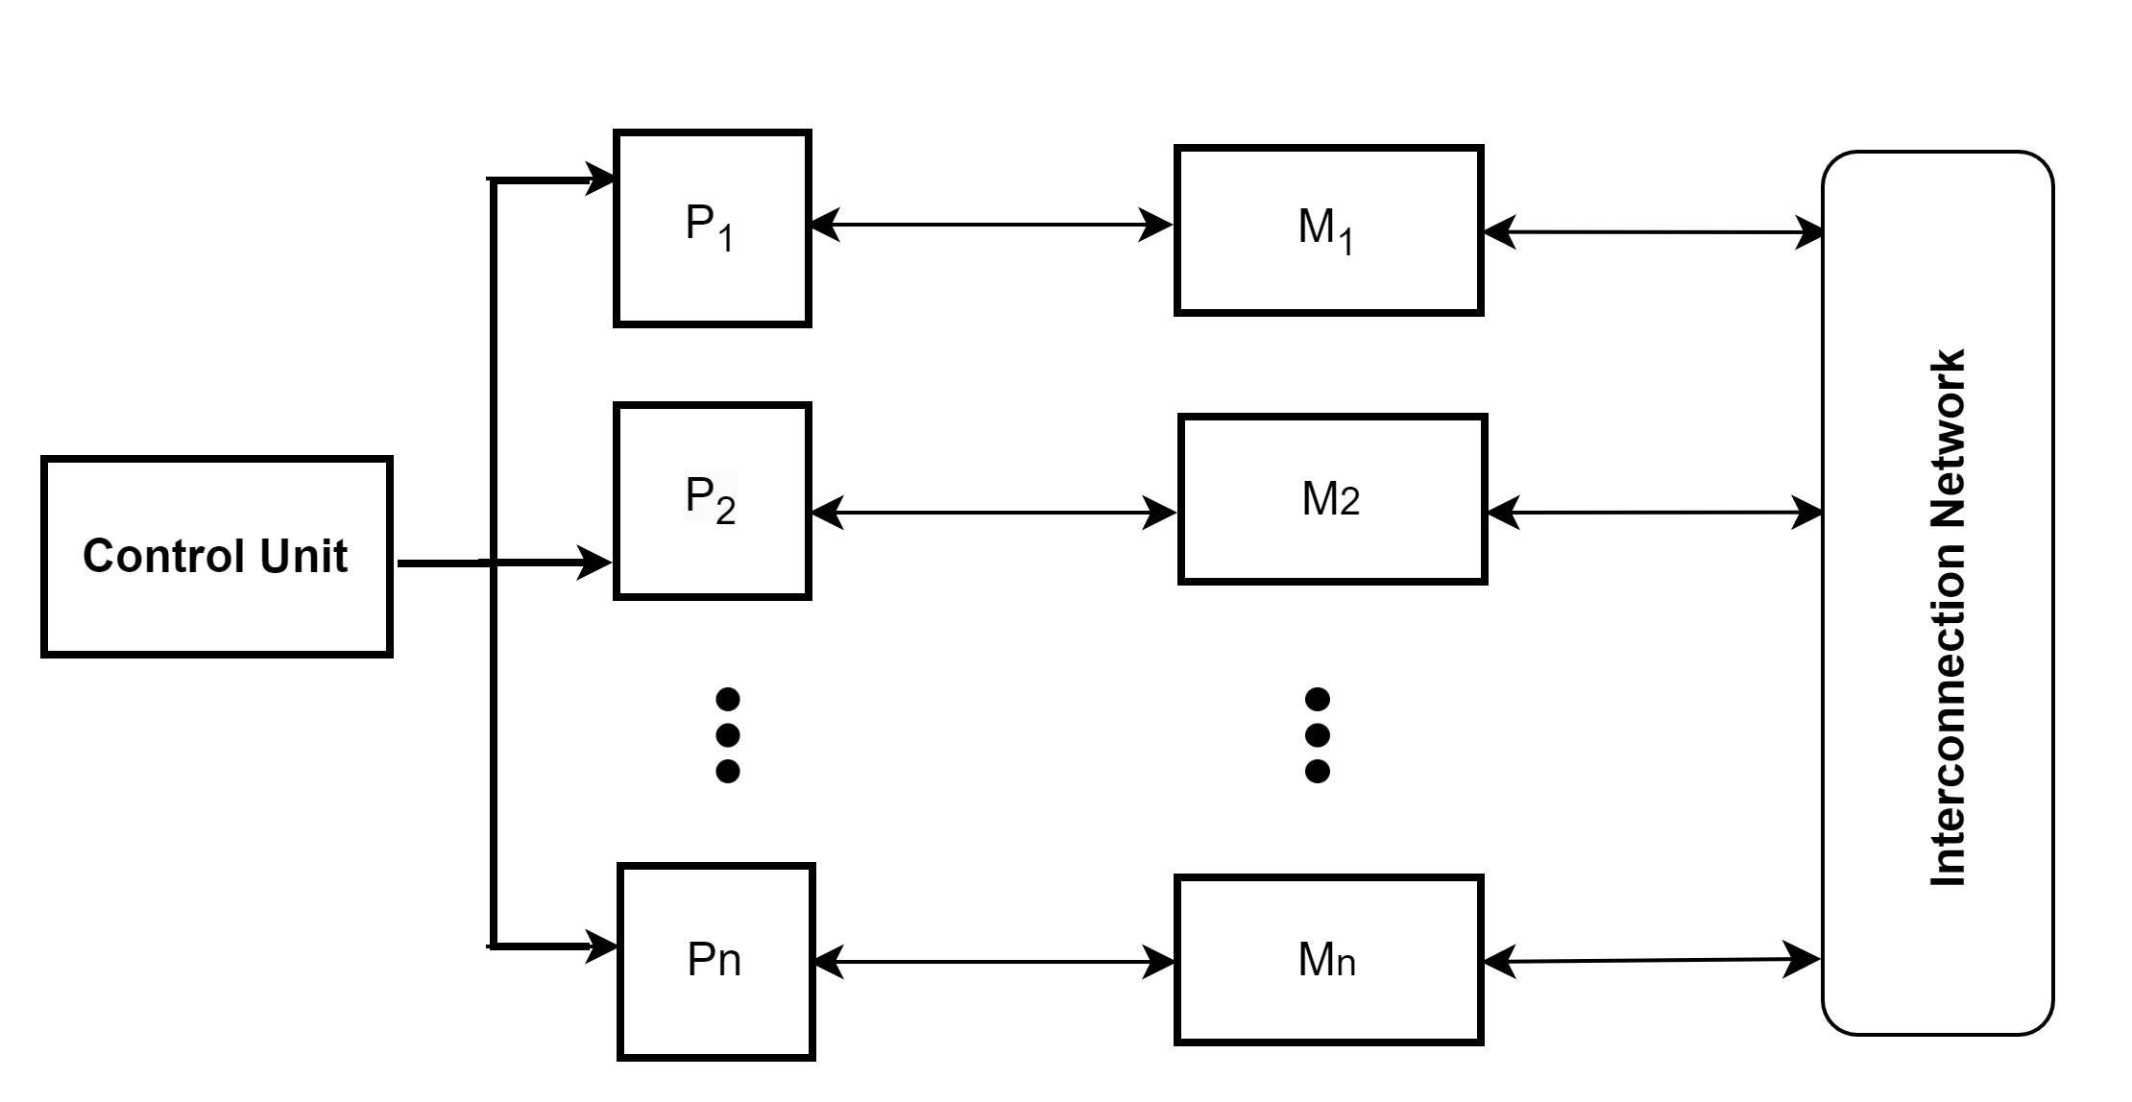
SIMD (Single-Instruction Multi-Data) Scheme Cont…
SIMD Scheme 1

Slide 34
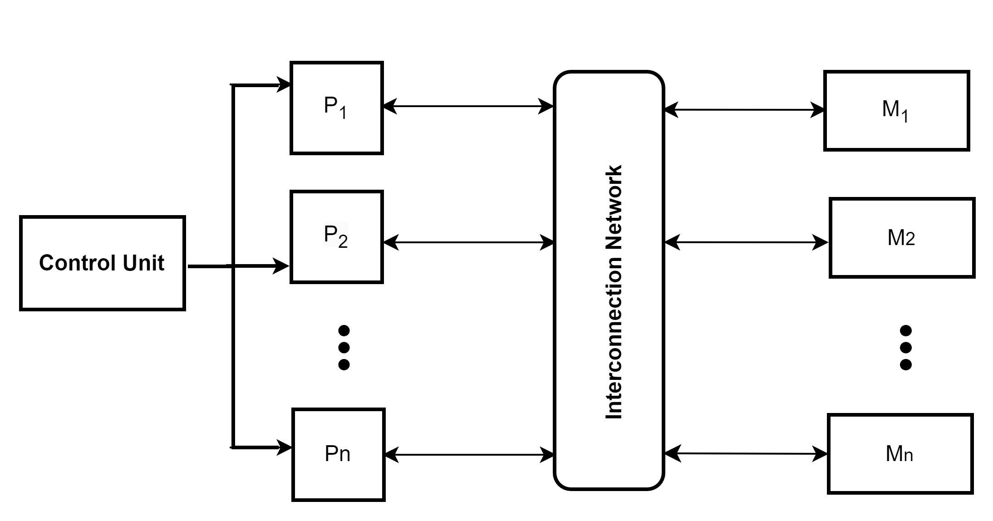
SIMD (Single-Instruction Multi-Data) Scheme Cont…
SIMD Scheme 2

Slide 35
CS621 Parallel and Distributed Computing
MISD (Multiple-Instruction Single-Data)

Slide 36
Objectives
Introduction of MISD.
MISD Architecture.

Slide 37
MISD (Multiple-Instruction Single-Data)
“A pipeline of multiple independently executing functional units operating on a single stream of data, forwarding results from one functional unit to the next."

Slide 38
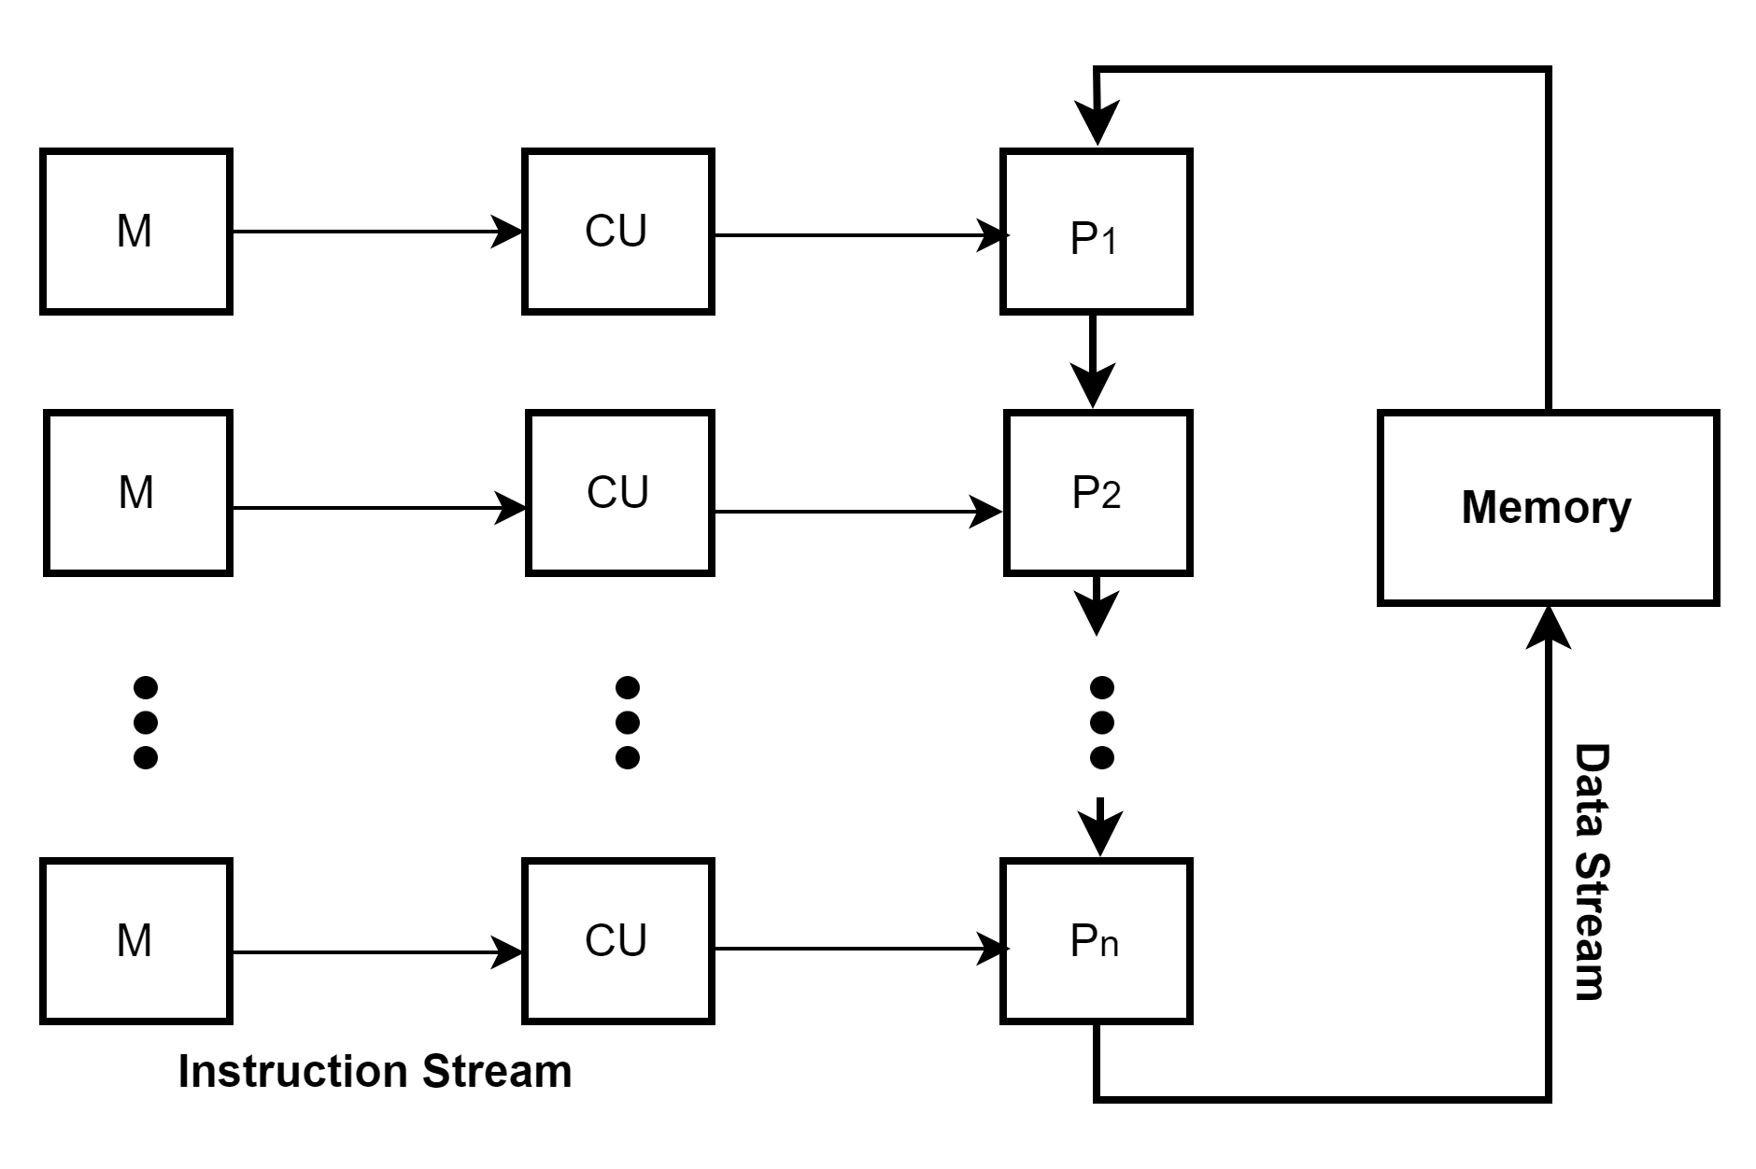
MISD (Multiple-Instruction Single-Data) Architecture

Slide 39
MISD (Multiple-Instruction Single-Data) Cont…
Special purpose computer
Excellent for situation where fault tolerance is critical
Heterogeneous systems operate on the same data stream and must agree on the result
Rarely used; some specific use systems (space flight control computers)
Example: Systolic array

Slide 40
CS621 Parallel and Distributed Computing
MIMD (Multi-Instruction Multi-data)

Slide 41
Objectives
Introduction of MIMD.
MIMD Architecture.
MIMD Shared Memory & Message Passing Architectures.

Slide 42
MIMD (Multi-Instruction Multi-data)
“In MIMD all processors in a parallel computer can execute different instructions and operate on various data at the same time.”

Slide 43
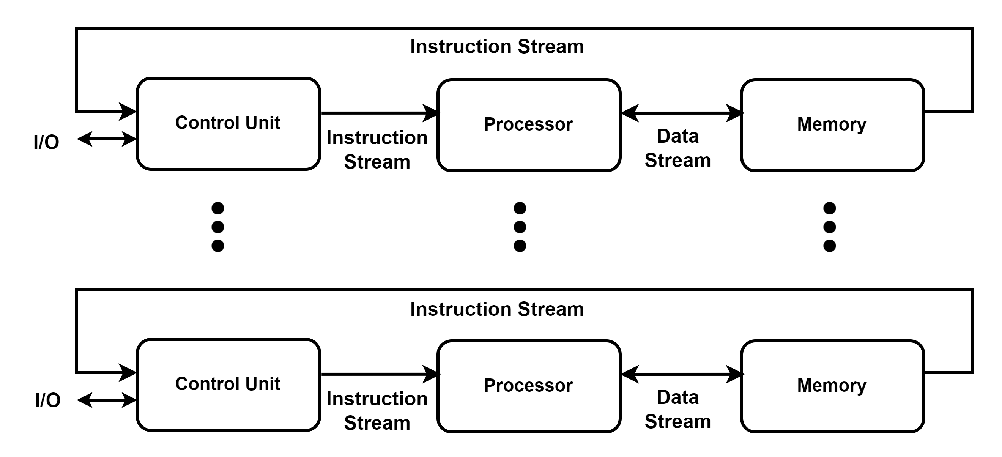
MIMD (Multi-Instruction Multi-data) Architecture

Slide 44
MIMD (Multi-Instruction Multi-data) Cont…
MIMD processors can execute different programs on different processors.
Each processor has a separate program, and an instruction stream is generated from each program.
Parallelism achieved by connecting multiple processors together.
Different programs can be run simultaneously.
Each processor can perform any operation regardless of what other processors are doing.
Examples: S-1, Cray-3, Cray T90, Cray T3E, Multiprocessor PCs and 370/168 MP

Slide 45
MIMD (Multi-Instruction Multi-data) Architecture Cont…
Special purpose computer
Shared or distributed memory
Made of multiple processors and multiple memory modules connected via some interconnection network.
Classified into two configuration schemes:
Shared memory
Message passing

Slide 46
MIMD (Multi-Instruction Multi-data) Cont…
Shared Memory Organization
Inter-processor coordination is accomplished by reading and writing in a global memory shared by all processors.
Any processor can access then local memory of any other processor.
Typically consists of servers that communicate through a bus and cache memory controller.

Slide 47
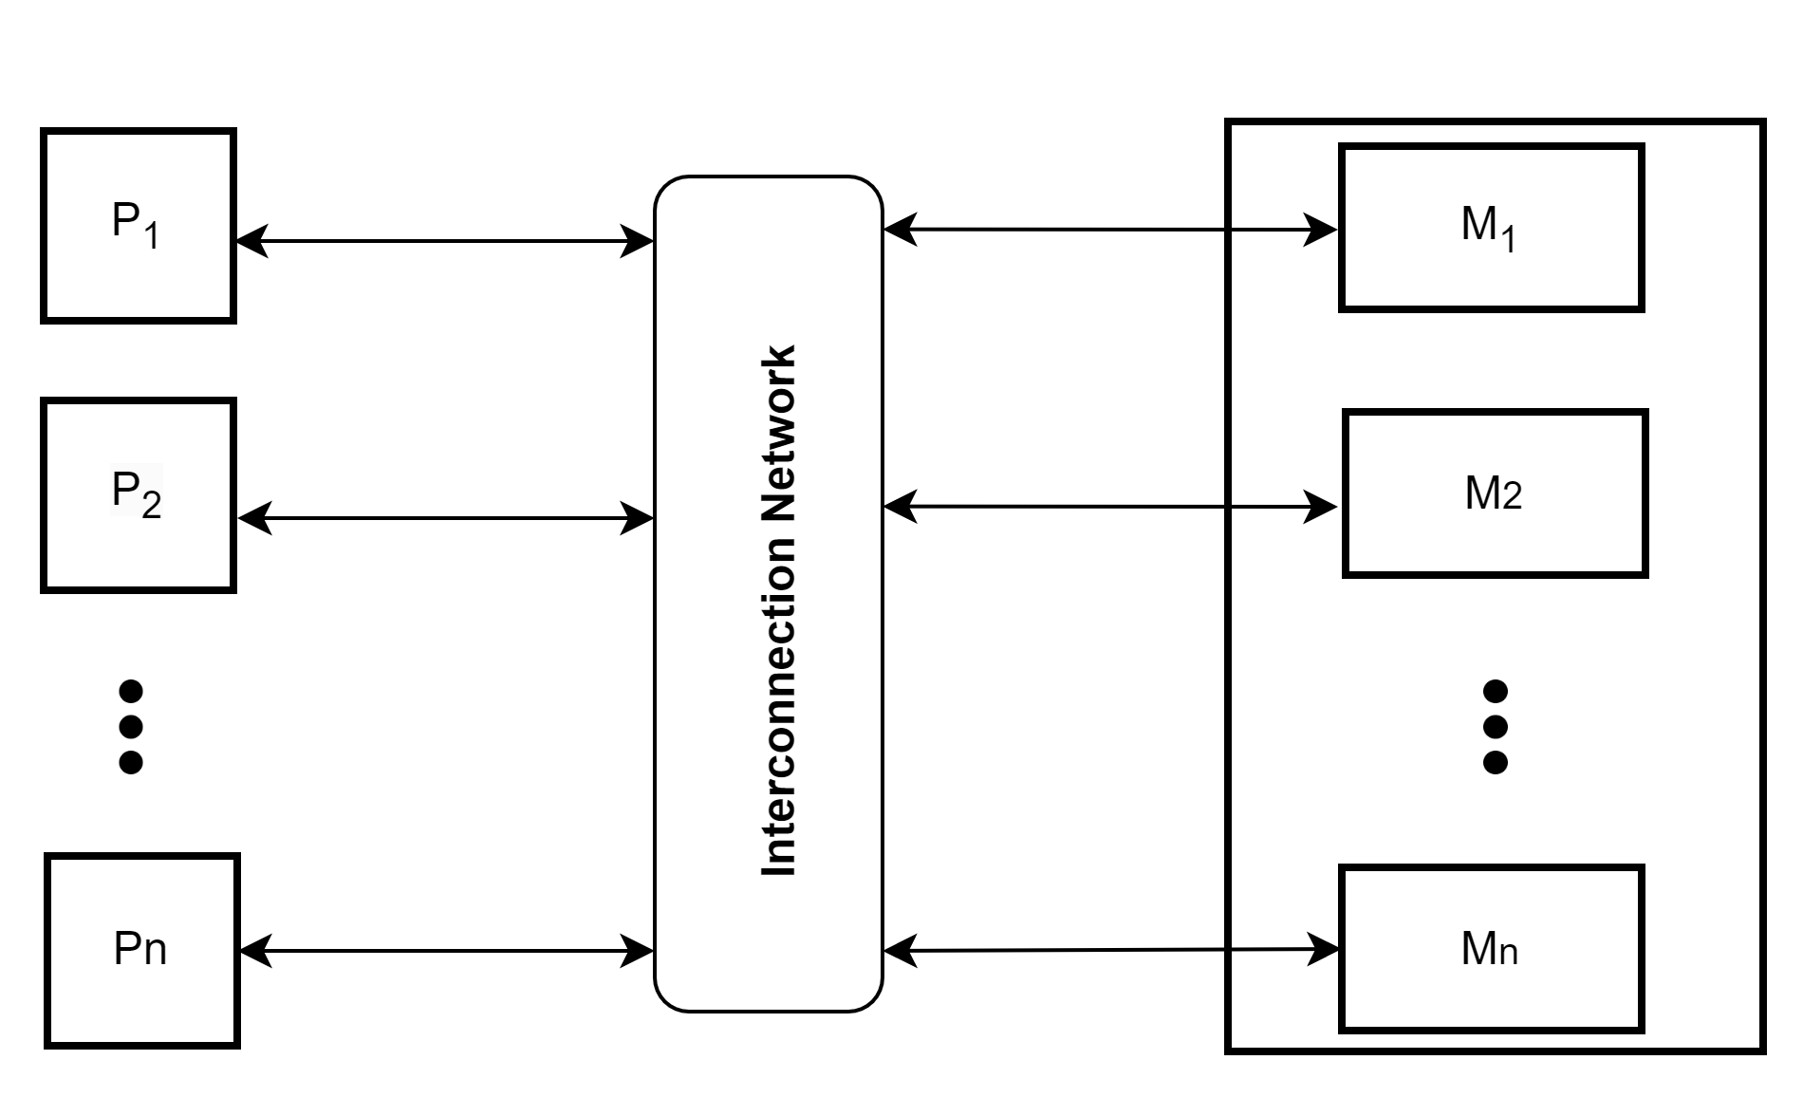
MIMD (Multi-Instruction Multi-data) Cont…
  Shared Memory Architecture

Slide 48
MIMD (Multi-Instruction Multi-data) Cont…
Message Passing Organization
Point-to-Point
Each processor has access to its own local memory.
Communications are performed via send and receive operations.
Message passing multiprocessors employ a variety of static networks in local communications.
Must be synchronized among different processors.

Slide 49
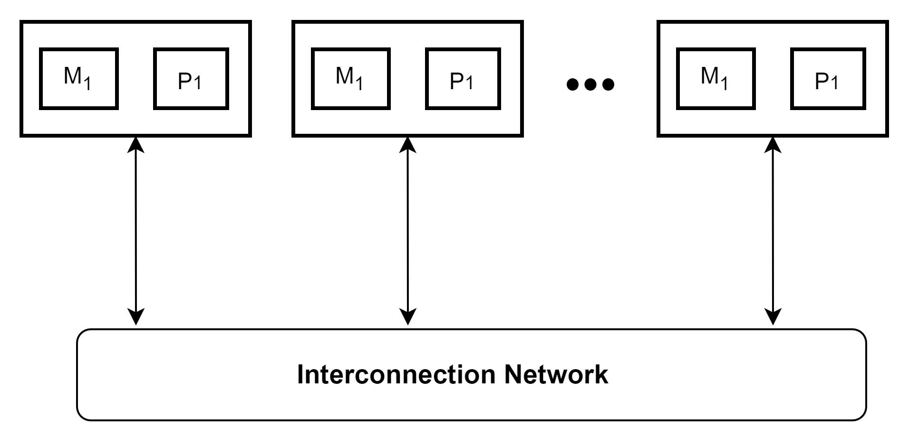
MIMD (Multi-Instruction Multi-data) Cont…
  Message Passing Architecture

Slide 50
CS621 Parallel and Distributed Computing
SIMD-MIMD Comparison

Slide 51
Objectives
Comparison of SIMD-MIMD.

Slide 52
SIMD-MIMD Comparison
SIMD computers require less hardware than MIMD computers (single control unit).
SIMD is less expensive as compared to MIMD.
SIMD follows synchronous processing where as, MIMD incorporates an asynchronous processing.

Slide 53
SIMD-MIMD Comparison Cont…
In MIMD each processing elements stores its individual copy of the program which increases the memory requirements. Conversely, SIMD requires less memory as it stores only one copy of the program.
MIMD is more complex and efficient as compared to SIMD.

Slide 54
SIMD-MIMD Comparison Cont…
Architecture | Single Instruction Multiple Data (SIMD) | Multiple Instruction Multiple Data (MIMD)
Type of processing | Same instruction on multiple data sets | Different instructions on multiple data sets
Flexibility | Limited | High
Memory access | Shared | Separate
Best suited for | Applications with regular data parallelism | Applications with irregular data dependencies or complex computations
Performance | High efficiency for parallelizable tasks | Flexible, but may be less efficient for parallelizable tasks

